Slide 1
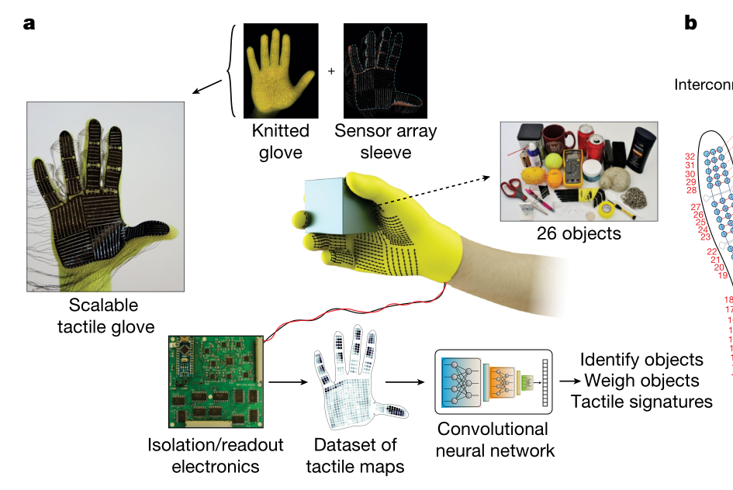
Learning the signatures of the human grasp using a scalable tactile glove
https://www.nature.com/articles/s41586-019-1234-z

Slide 2
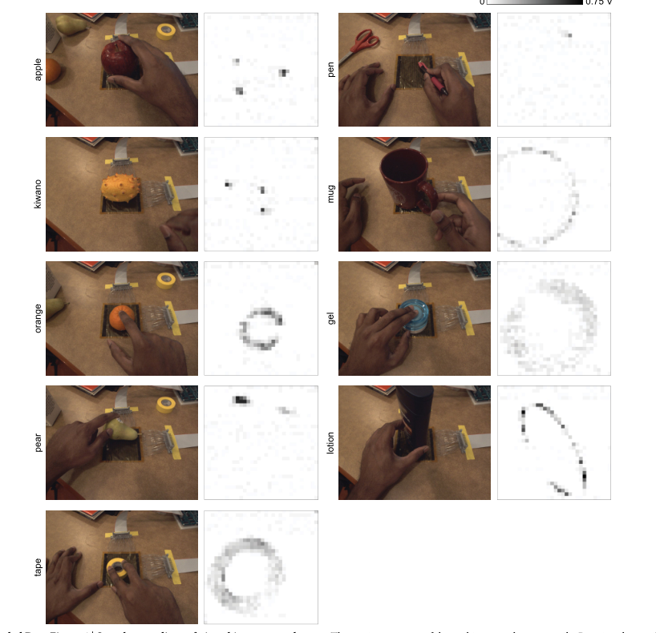
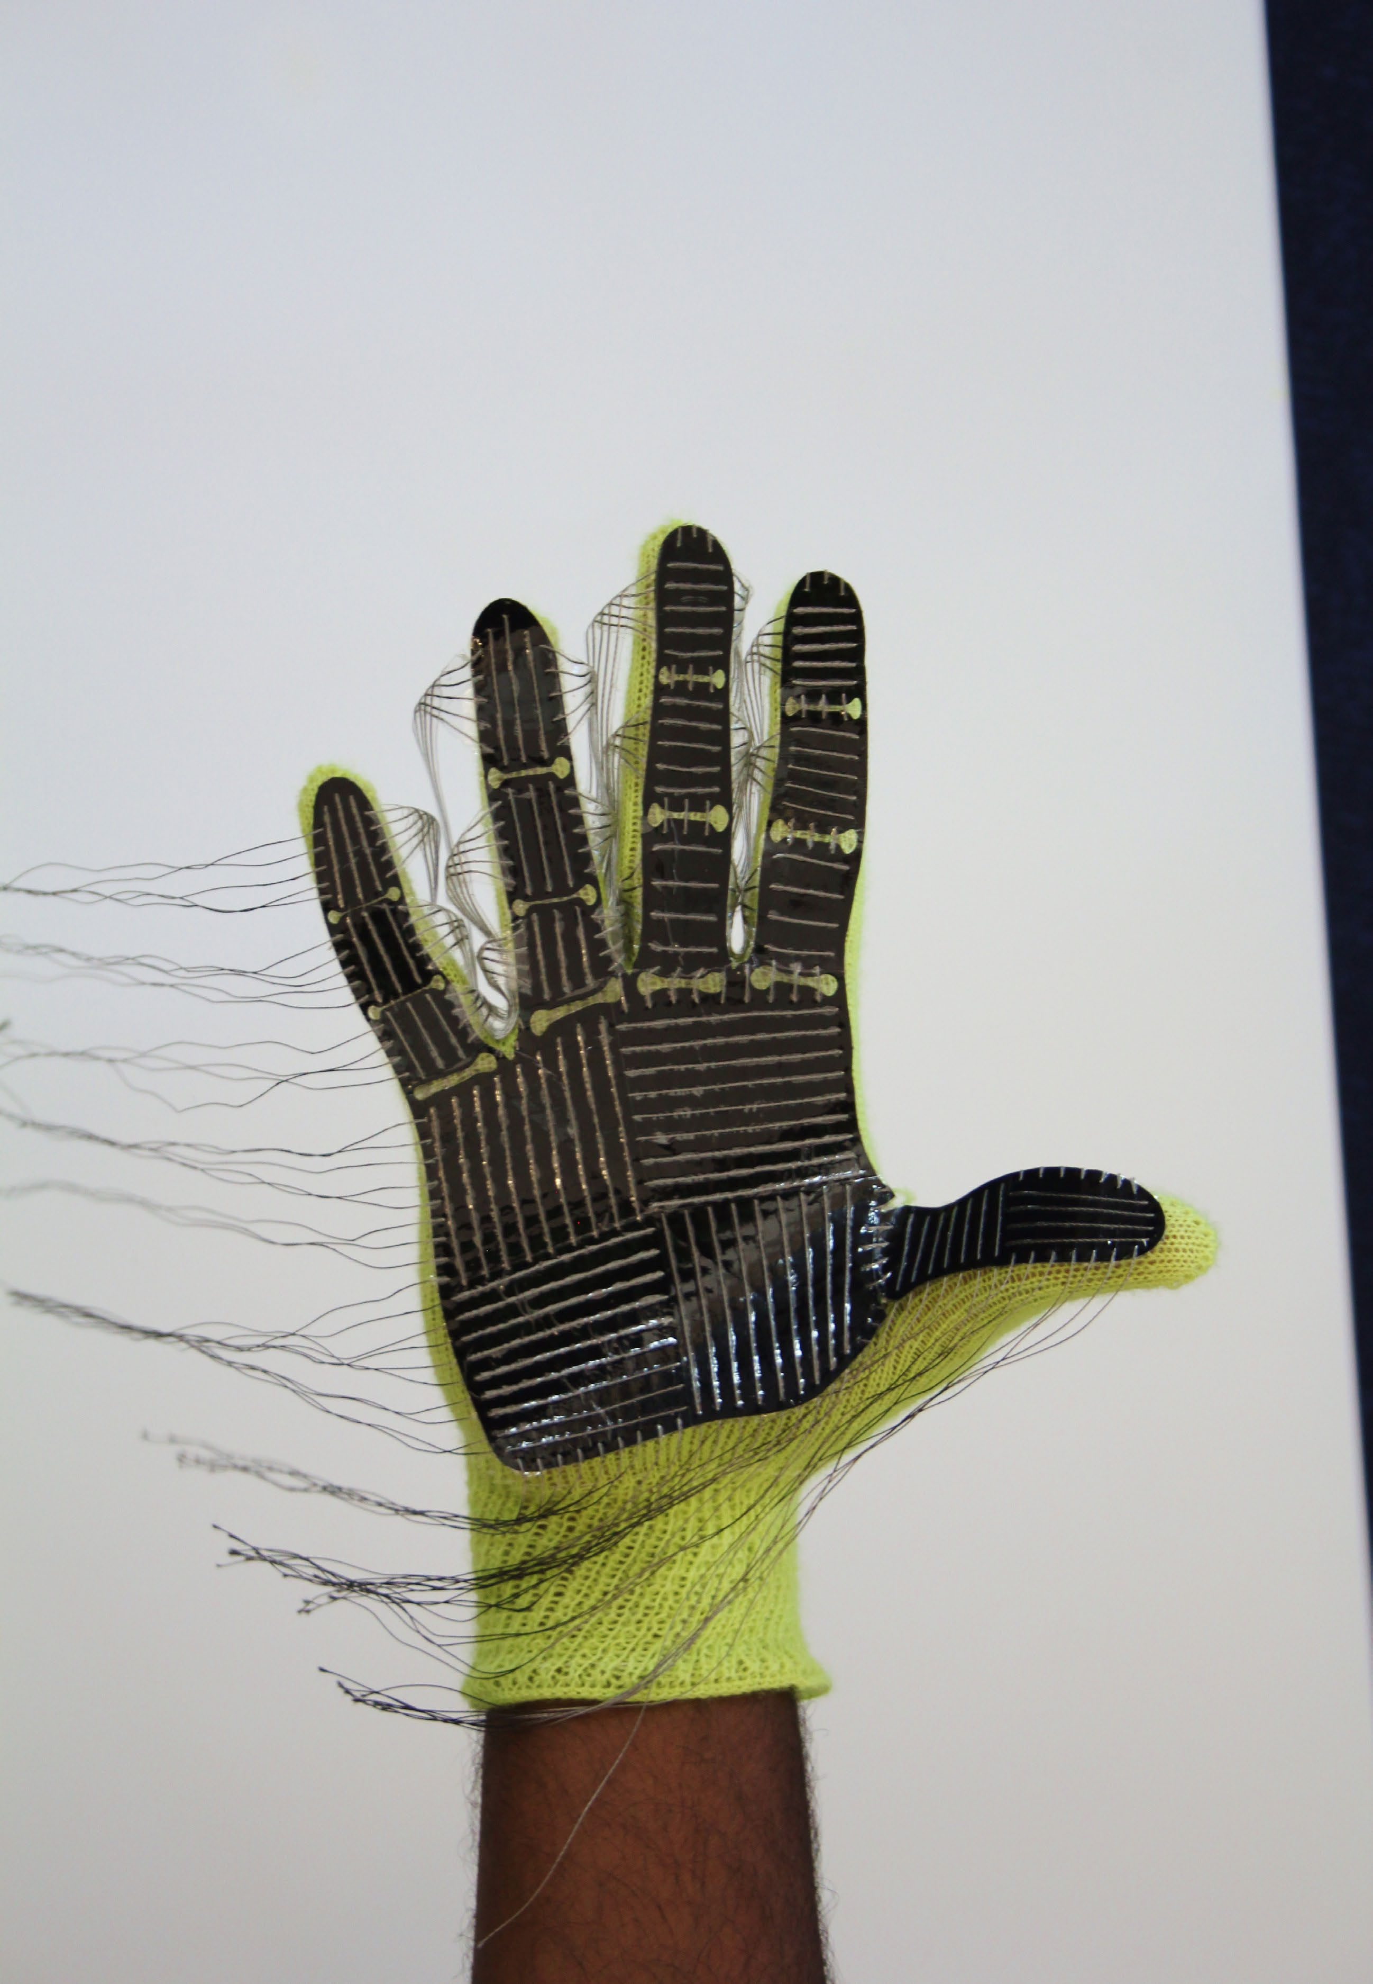
Sample recordings of nine objects on regular
32 × 32 arrays on a flat surface.

Slide 3
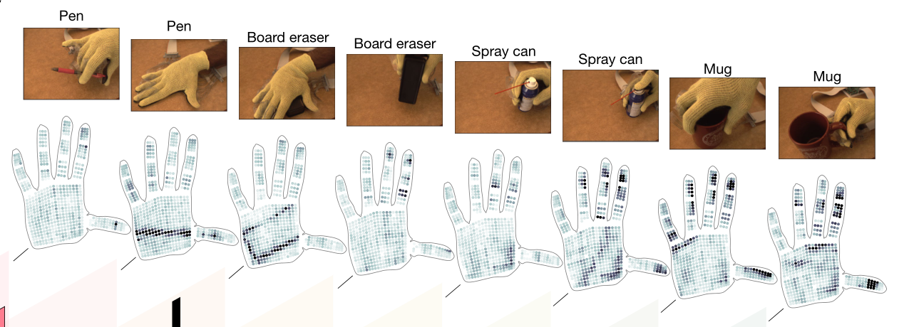

Slide 4

Teaching AI to create visuals with more common sense
https://www.csail.mit.edu/news/teaching-ai-create-visuals-more-common-sense

